Slide 1
SOAP MESSAGE EXCHANGE MODEL
Prof.M.Sudha

Slide 2
SOAP Message Exchange Model
Message path & Actors
Sender-Intermediary1-Intermediary2..-Receiver.
- . . message path …. -
- actor1 - actor 2 -
Construction of message path is not covered by SOAP specification , there are extensions to SOAP like Microsoft SOAP routing protocol to fill this gap
WS-Routing (But still there is no standard)
This mechanism only used in header block not in the body using actor attribute
Prof.M.Sudha

Slide 3
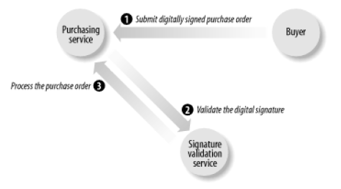
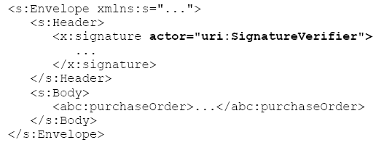
Example: actor
Prof.M.Sudha

Slide 4
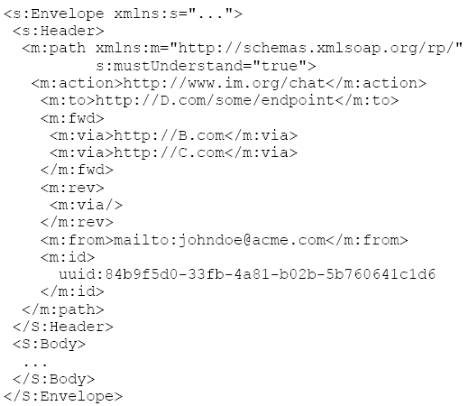
WS-Routing Message
Prof.M.Sudha

Slide 5
SOAP-Encoding
Envelope – packaging data
Message – Serialization of data
Encoding: ‘a simple type system that is the generalization of the common features found in programming languages, databases and semi-structured data’
Where encoding rules needed?
  To allow applications dynamically exchange information without a priori knowledge of the types of information to be exchanged.
Prof.M.Sudha

Slide 6
Encoding…
Terminology : value & accessor
value : single / combination of data unit(s)
accessor:
element that contains / allows to access a value.
Accessor Types:
  Single referenced / multi referenced
Prof.M.Sudha

Slide 7
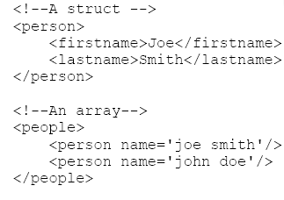
Structure & Arrays
Prof.M.Sudha

Slide 8
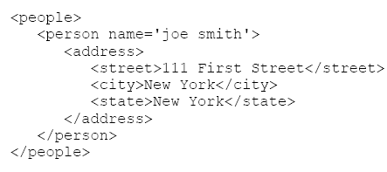
Single-referenced accessor
Does not have an identity except as a child of its parent element
Prof.M.Sudha

Slide 9
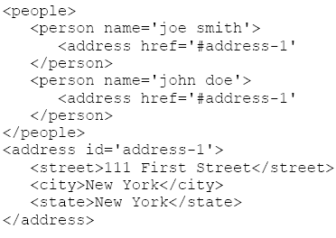
Multi-referenced accessor
Uses id to give identity to its value, other accessors can use the href attribute to refer to their values. ( the reference can also be an external XML document)
Prof.M.Sudha

Slide 10
Data Types within SOAP envelope
SOAP uses 3 difference ways to express the data type of an accessor
  Use xsi:type on each accessor (data type according to XML schema specification)
    Ex: <person><name xsi:type=“xsd:string”>VIT</name></person>
  Reference an xsd that defines exact data type of a particular element
    <person xmlns=“VIT.xsd”> <name>VIT</name></person>
  Reference some other type of schema document
    <person xmlns=“urn:vit_namespace”><name>VIT</name></person>
Prof.M.Sudha

Slide 11
SOAP Data Types
Anonymous accessor syntax
  <SOAP-ENC:int> 45 </SOAP-ENC:int>
Named accessor syntax
  <value xsi:type =“xsd:int”>45</value>
Multiple references in XML-encoded data
  <SOAP-ENC:int>31</SOAP-ENC:int>
  <SOAP-ENC:int>31</SOAP-ENC:int>
<value xsi:type="xsd:int" id="v1">31</value>
<value href="#v1" />
Prof.M.Sudha

Slide 12
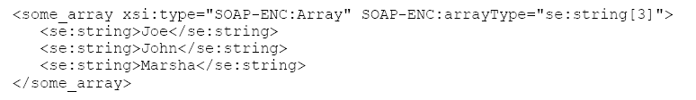
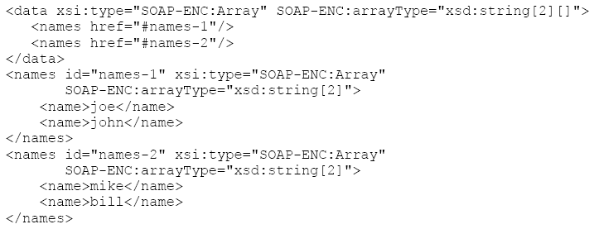
arrayType attribute
2-dimensional array
Prof.M.Sudha

Slide 13
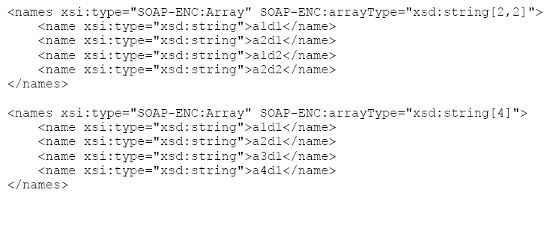
Comparison of 2-d and 1-d array
Prof.M.Sudha

Slide 14
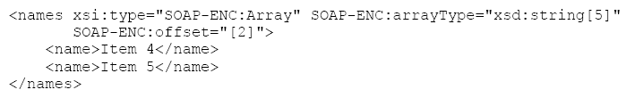
SOAP-ENC:offset for partially transmitted arrays
Prof.M.Sudha

Slide 15

SOAP-Serialization of sparse arrays
Prof.M.Sudha

Slide 16
Null accessors
Prof.M.Sudha

Slide 17
SOAP Web Services (Refer Lecture Notes)
Creating web services in .NET
Deployment
Invoking the service using SOAP
System.Web.Services.WebServiceBindingAttribute
System.Web.Services.Protocols.SoapHttpClientProtocol
Interoperability issues
  SOAP faults,SOAP::LITE, Perl client to work with .NET.
Prof.M.Sudha

